Slide 1


DIGITAL IMAGE PROCESSING COURSE PROJECT
IMAGE CLASSIFICATION USING CNN
TEAM MEMBERS:
RAHUL R.K
SHREYAS KULKARNI

Slide 2
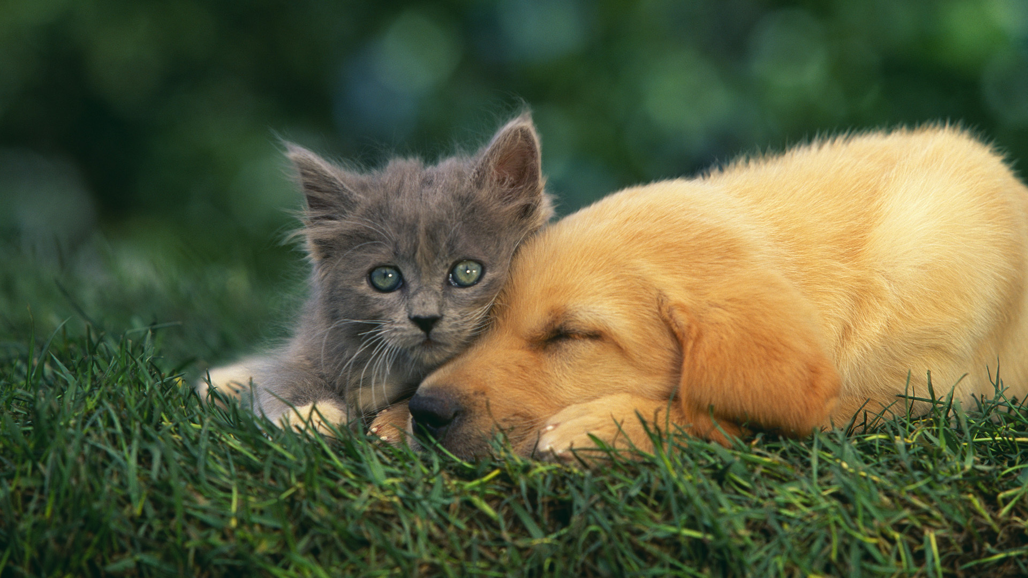

Slide 3
IN THIS PRESENTATION
CNN in classification
Steps used for classification
Convolution
Rectified Linear Unit
Pooling and its advantages

Slide 4
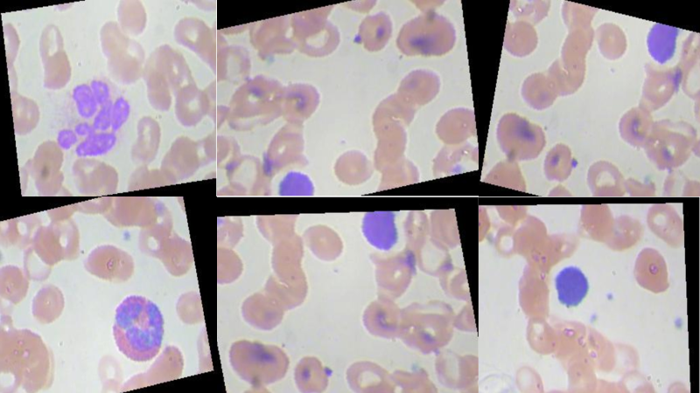

Slide 5
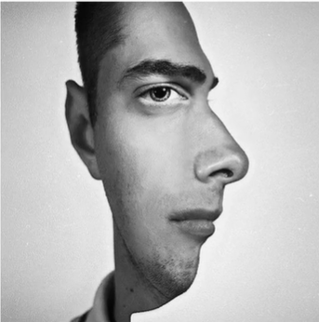
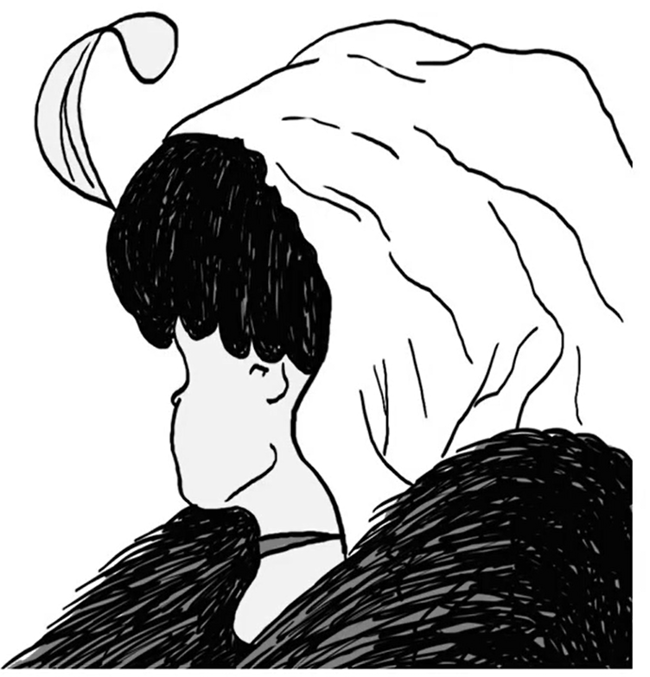
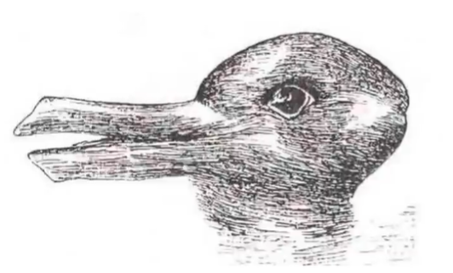
CNN INTUITION
We see features depending on how we see it.
Natural tendency to categorize things.
Notes:
Need to discuss feature-extraction points

Slide 6
WHY CNN?
Develops an internal representation of a two-dimensional image. Allows model to learn position and scale in variant structures in data, which is important when working with images.
CNN retain spatial structure in image.
They use fewer parameters to learn.
Automatically learn and generalize features from the input domain.

Slide 7
WHAT IS A CONVOLUTIONAL NEURAL NETWORK?
CNN is a deep learning algorithm which can take in input data assign importance to various aspects in the data and be able to differentiate one from the other.
Has building blocks:
Convolutional layer
Pooling layer
Rectified Linear Unit (ReLu)
Fully connected layer
Loss layer
CNN is used mainly for image classification purposes.

Slide 8
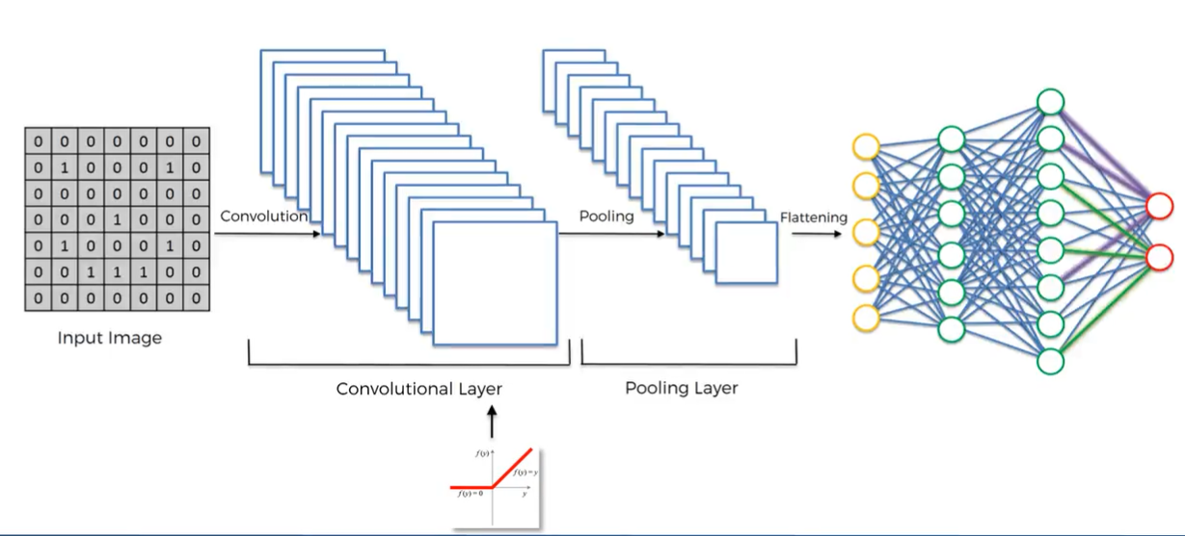
STRUCTURE OF CNN

Slide 9
CONVOLUTION
Has 3 parts
Input image
Feature detector
Feature map
There is loss of information.
Only the required information is extracted and the rest are filtered out.
A collection of feature maps is called CONVOLUTIONAL LAYERS.

Slide 10
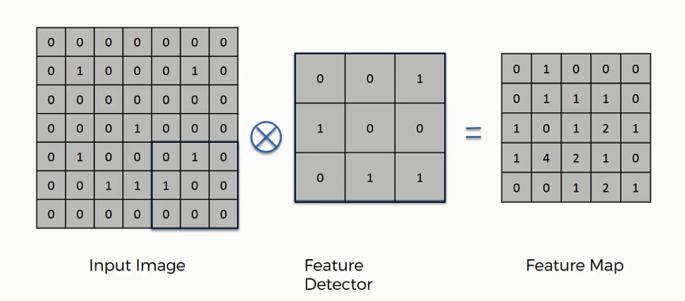
HOW CONVOLUTION WORKS

Slide 11
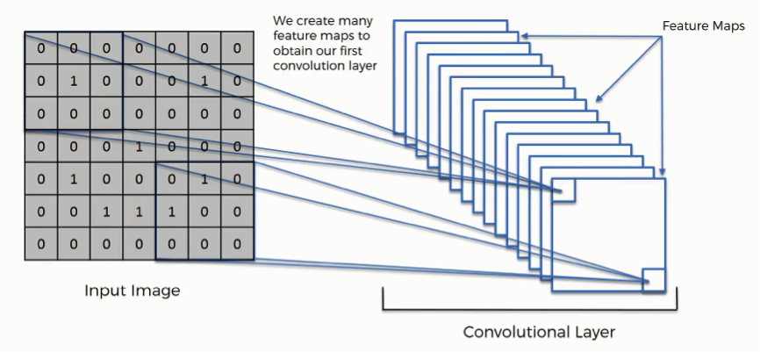
CONVOLUTION

Slide 12
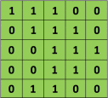
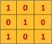

EXAMPLE FOR CONVOLUTION
INPUT IMAGE: FEATURE DETECTOR:
CONVOLUTION:

Slide 13
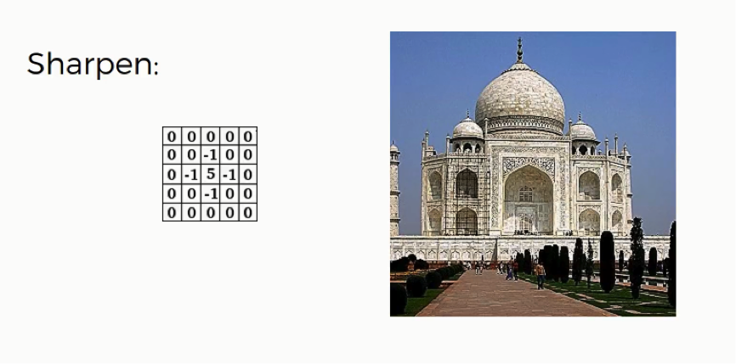
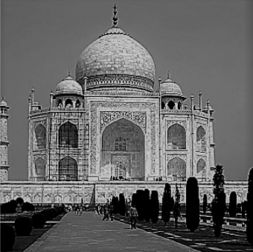
SOME OF THE INITIAL FILTERS USED IN CONVOLUTION

Slide 14
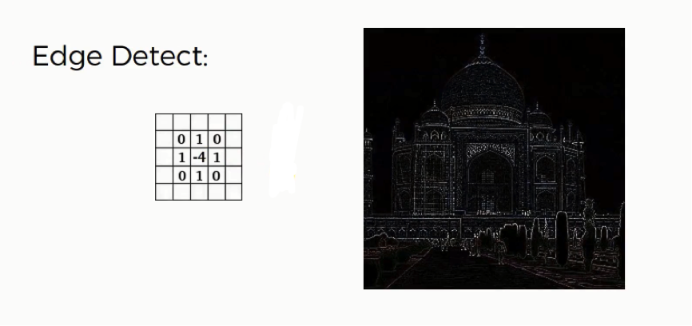
SOME OF THE INITIAL FILTERS USED IN CONVOLUTION

Slide 15
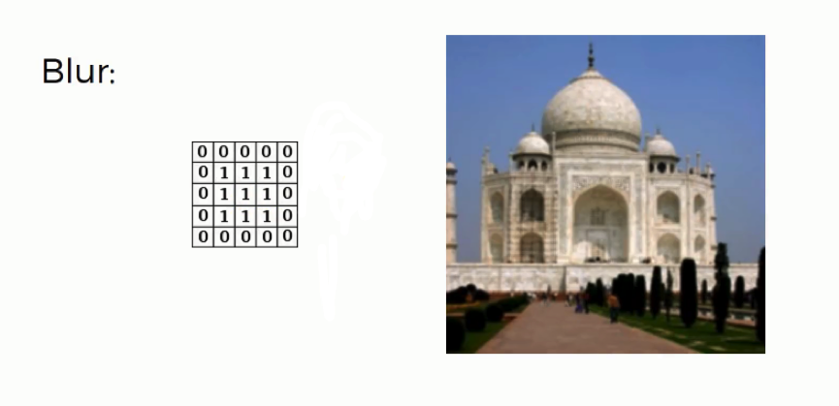
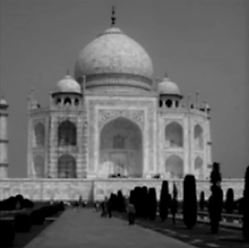
SOME OF THE INITIAL FILTERS USED IN CONVOLUTION

Slide 16
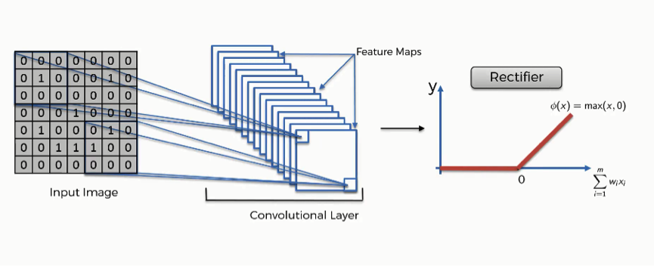
RECTIFIED LINEAR UNIT (ReLU)

Slide 17
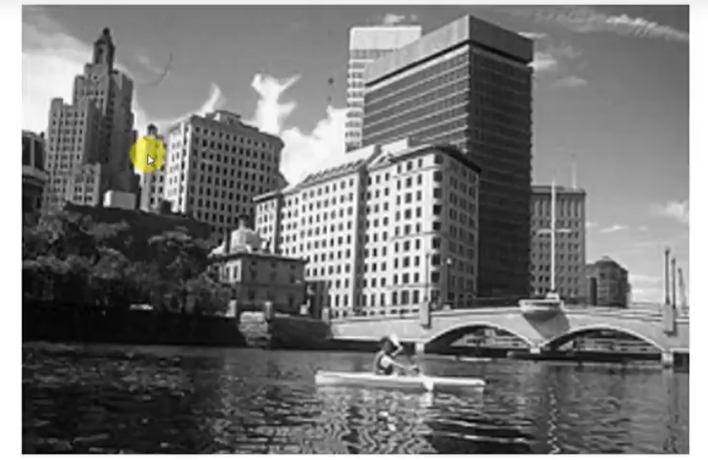
RECTIFIED LINEAR UNIT (ReLU)
Increases the non linearity of the image.
ReLU is a better activation function than sigmoid.
Removes all the black elements from it, keeping only those carrying a positive value (the grey and white colors).
CONVOLUTION

Slide 18
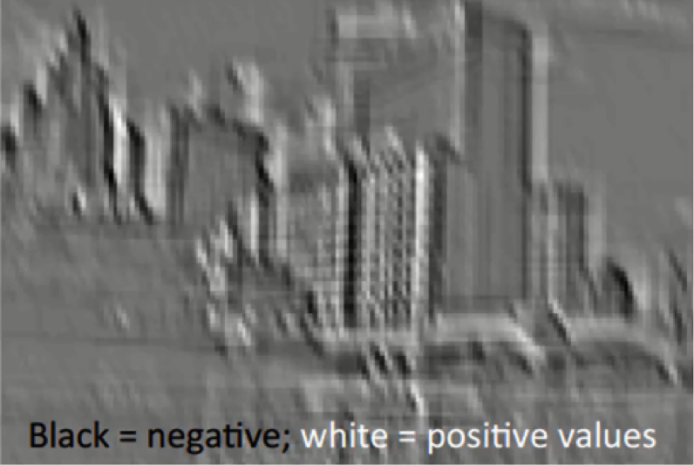
RECTIFIED LINEAR UNIT (ReLU)
CONVOLUTION
ReLU

Slide 19
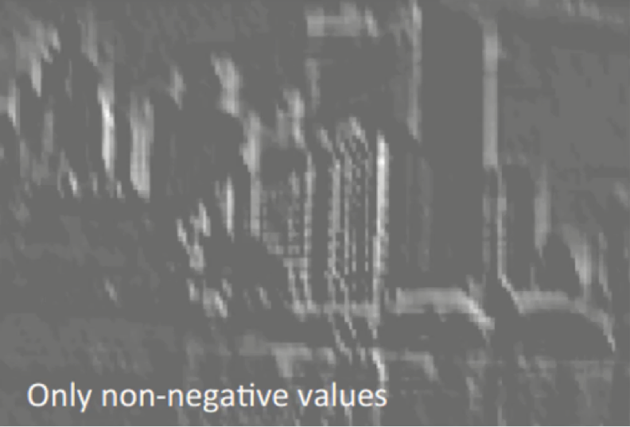
RECTIFIED LINEAR UNIT (ReLU)
ReLU
Black section removed.
Only white-gradients present.

Slide 20
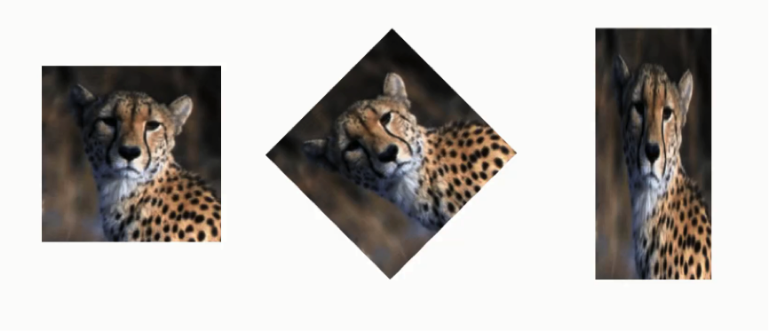
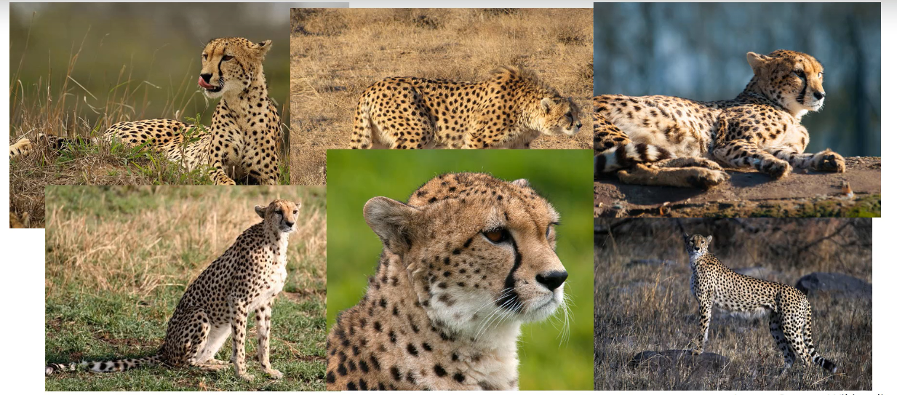
MAX POOLING
The purpose of max pooling is to detect features when present in any manner (tilted, rotated, placed closer, placed further apart)
Reduces computational complexity.

Slide 21
MAX POOLING
Record maximum value in each block.
Features are preserved (max values).
By pooling these features, unwanted information is removed.
So even if image is rotated we preserve the important features.

Slide 22
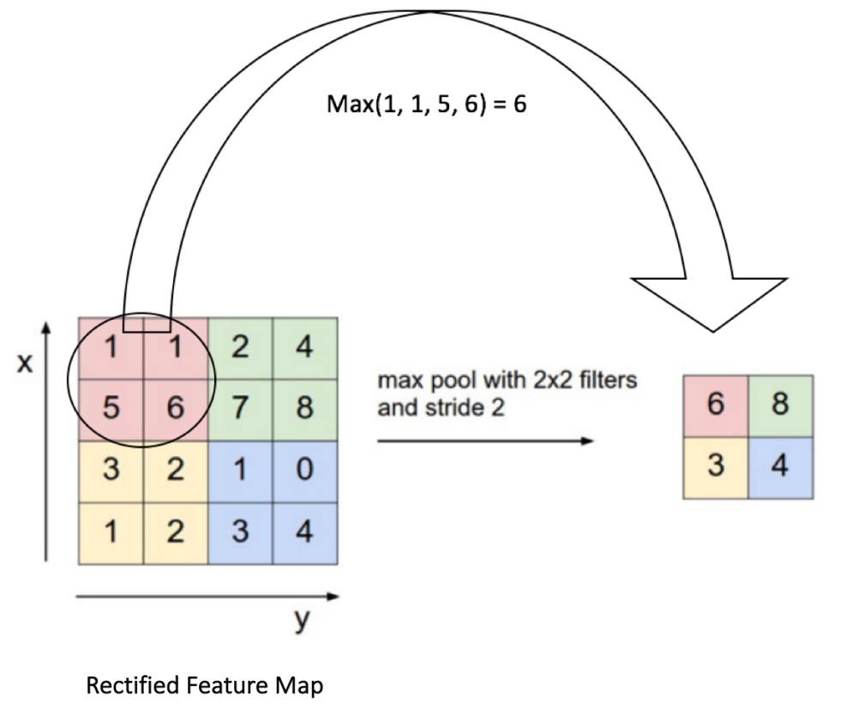
EXAMPLE OF MAX POOLING

Slide 23
ADVANTAGES OF MAX POOLING
Why max pooling over mean pooling?
Mean pooling smoothens out the image, so its hard to detect the edges and other features.
Max pooling selects the brighter pixels from the image. Hence making it efficient when background is dark.
Mean pooling results in bad accuracy.
In the feature map, the pixel with the highest values represent where the features are detected.

Slide 24

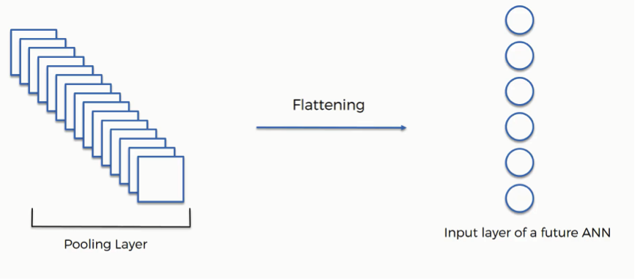
FLATTENING LAYER
Converting N by N image into N by 1 image.
This N by 1 image becomes the input to the Neural network.

Slide 25
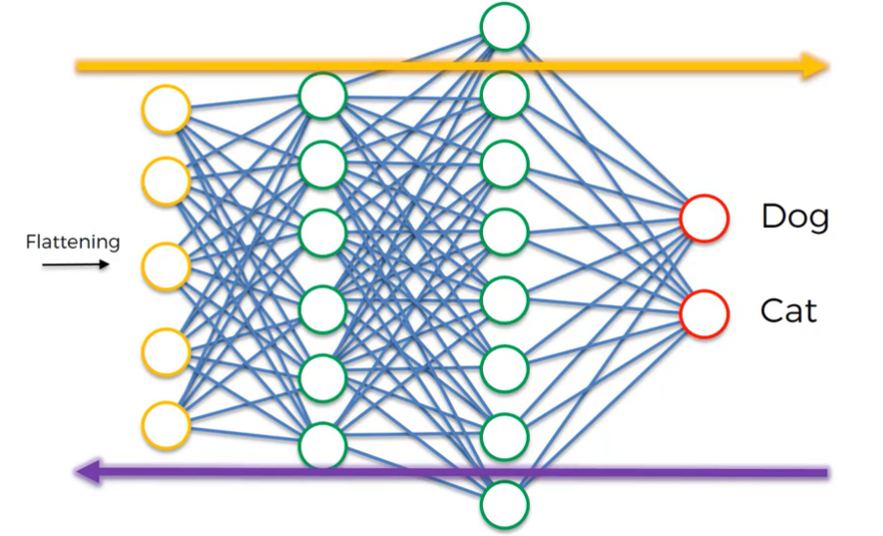
FULLY CONNECTED LAYER(NEURAL NETWORK)
Information fed through network.
Cost function must be reduced.
Error calculated and backpropagated through the network.
Weights are adjusted to optimize the network.
Feature detector also adjusted because we assume that we are looking for the wrong features and hence the large error.

Slide 26
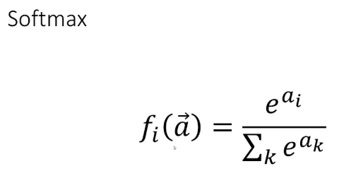
SOFTMAX layer
This layer has same number of nodes as the number of neurons in the Output layer.
Softmax function takes an N-dimensional vector of real numbers and transforms it into a vector of real number in range (0,1) which add upto 1.

Slide 27
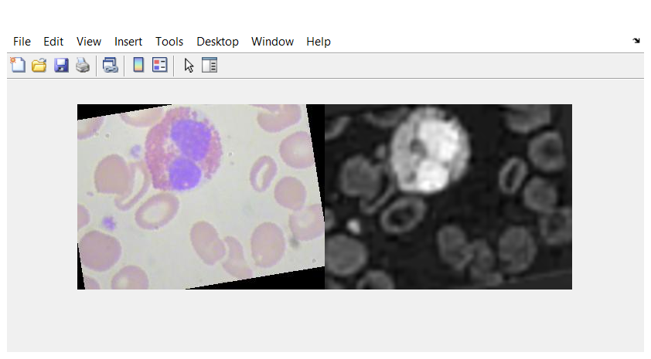
CONVERTING INTO GRAY SCALE

Slide 28
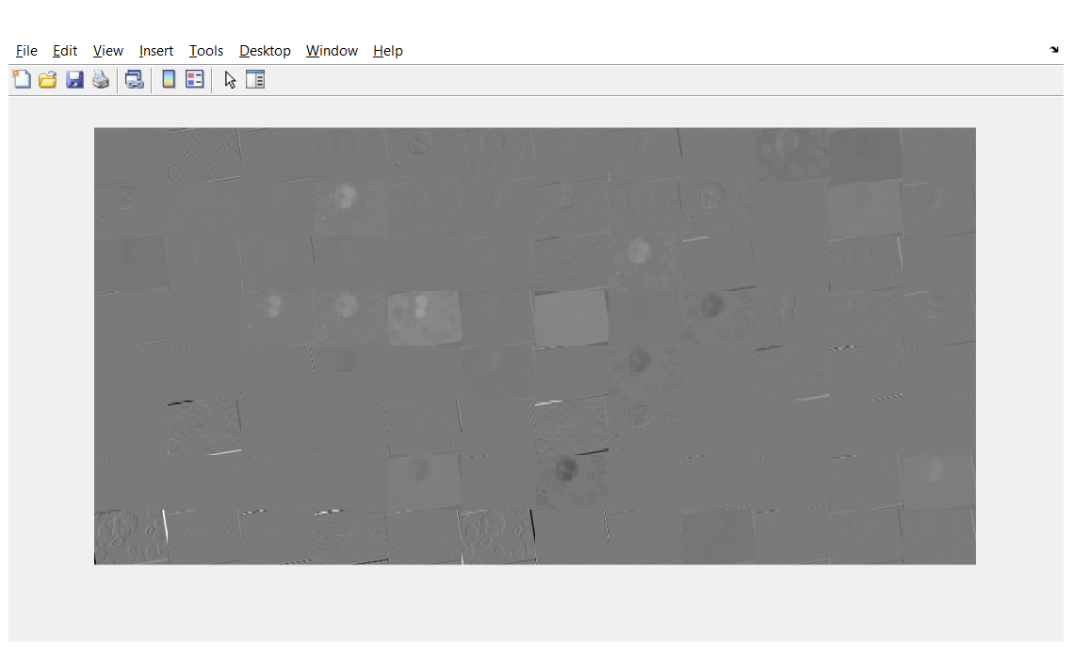
CONVOLUTION ON BLOOD CELL

Slide 29
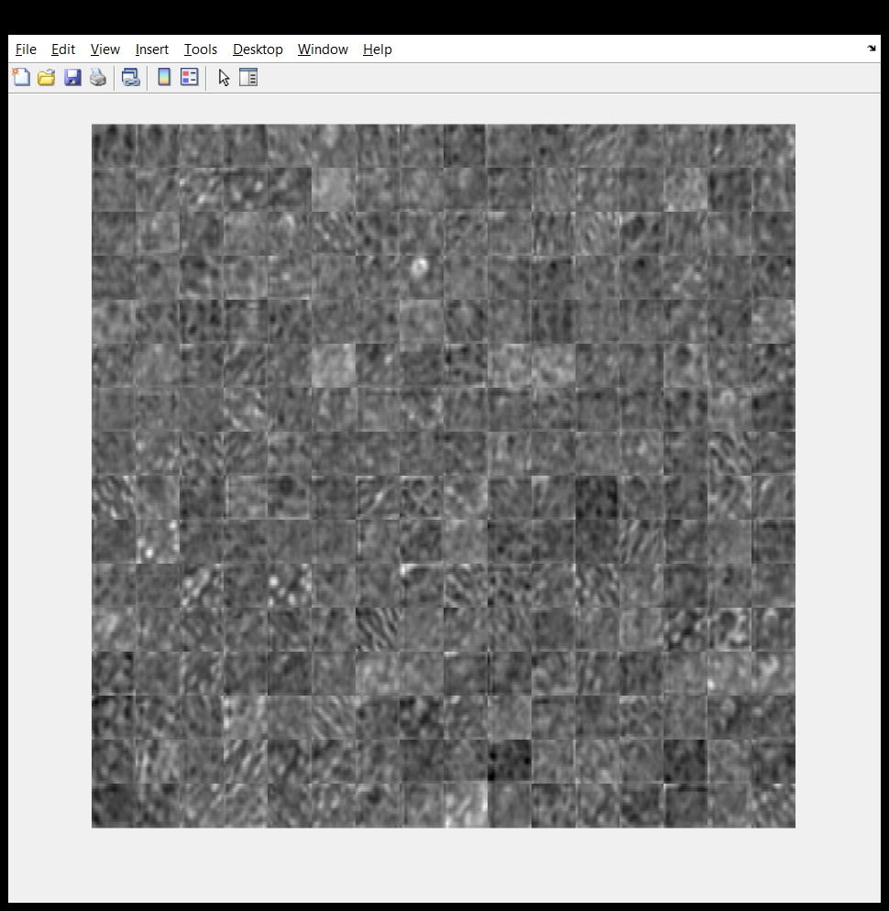
CONVOLUTION ON BLOOD CELL

Slide 30
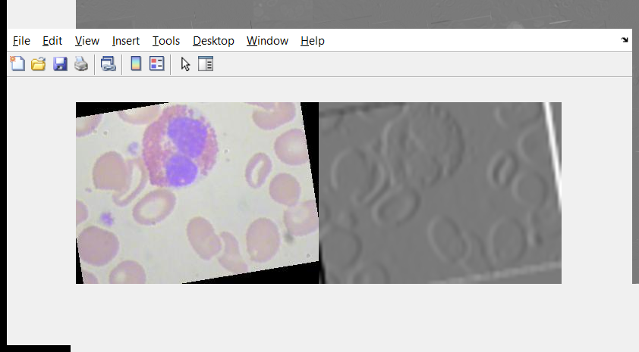
ReLU ON BLOOD CELL

Slide 31
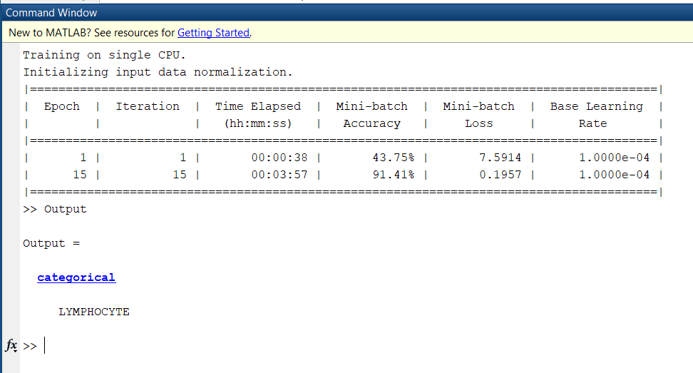
Classification of an image into one of two classes

Slide 32
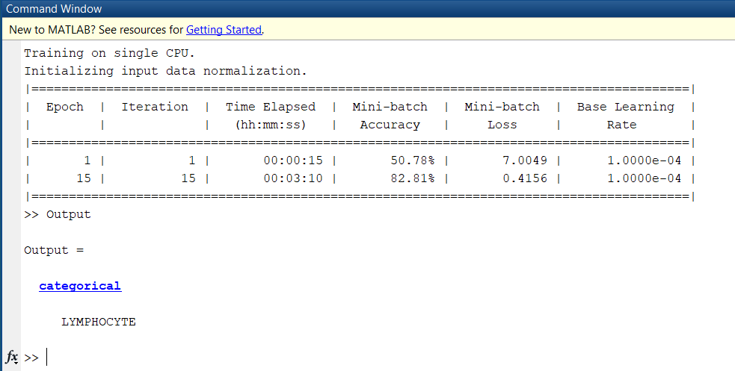
Classification of an image into one of 3 classes

Slide 33
THAT’S ALL WE’VE GOT FOR NOW THANK YOU

